Slide 1


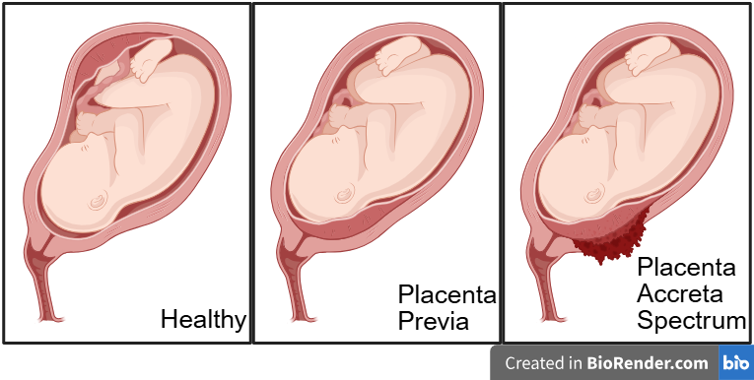
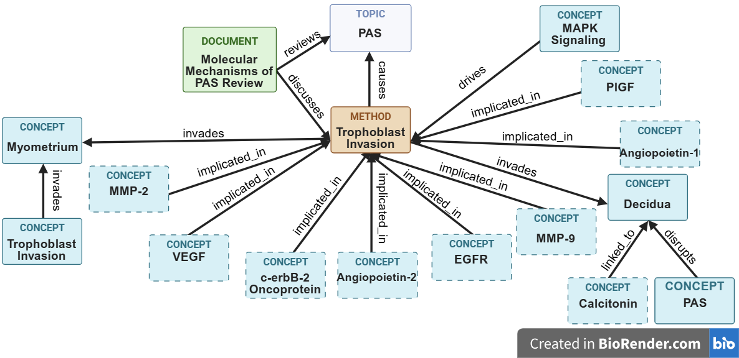

Building an AI-Powered Knowledge Base for Biomarkers of Abnormal Placentation Disorders
AIBIDS is supported by grant R25LM014208 from the National Library of Medicine and a Momentum Grant from the University of Pittsburgh​
Puskar, Jillian E.; Gopalakrishnan, Vanathi
Introduction
Results
Validation
Abnormal placentation disorders are associated with severe hemorrhage and invasive treatments during pregnancy and are on the rise due to several factors such as an increase in prior cesarean sections.
Placenta accreta spectrum (PAS), a condition caused by the abnormal adherence of the placenta to the uterine wall, occurs in 1 in 272 pregnancies.
Placenta previa (PP), a condition in which the placenta implants low into the uterus and blocks the cervix, occurs in 4 in every 1000 pregnancies.
While multimodal biomarkers exist and may inform diagnosis or prognosis there is a lack of any readily accessible knowledge base (KB) for this problem.
Generative AI has made human-AI co-work possible for the efficient integrative discovery of multimodal biomarkers from literature.
Using an AI assistant, we built a preliminary large language model (LLM)-powered KB using a markdown-format repository to quantify and profile known biomarkers of abnormal placentation disorders, using PAS and placenta previa as the initial exploratory case studies.
Literature search yielded 30 full-text, accessible papers.
Manual extraction yielded 318 potential biomarkers.
Before training: Claude yielded 14 (circulating) biomarkers.
After review: Claude yielded ~145 (multimodal) potential biomarkers, needing evaluation.
Full results of the study can be found in our GitHub repository.
Baselines were generated by Gemini (3.5 Thinking), GPT (5.5), & Claude (Opus 4.8), paraphrased manually.
Five categories of evaluation: Accuracy, Relevance, Clarity, Completeness, & Falsity.
The evaluator rates its output against gathered baselines & the source data based on the rubric with PASS/FAIL.
The same rubric was used to validate the AI-evaluator’s evaluation against human validation ratings of the knowledge base.
Prompting strategies used: contextual, non-contextual, argumentative, querying.
Full results of the validation can be found in our GitHub repository.
Biomarkers | Source(s) | Count | Assoc. Condition(s)
sFlt-1 | Blood deriv. | 6 | PAS, PP
PlGF | Blood deriv., tissue | 6 | PAS, PP
VEGF, VEGF-A, VEGF-C | Blood deriv. | 6 | PAS
β-hCG (Free, Intact, -H) | Blood deriv. | 5 | PAS, PP
PAPP-A, PAPP-AS1 | Blood deriv., tissue | 5 | PAS, PP
Discussion
Challenges:
Strengths:
Demonstrated that human-AI co-work is feasible to create a preliminary knowledge repository from literature and harness relationships in a new domain.
Infrastructure is self-evolving, built incrementally.
Output is human-readable.
Identified >300 biomarkers for PAS, PP.
Human-AI co-work efficiency gains.
Limitations:
Only used Claude (Sonnet 5) for KB.
Only used PubMed for literature search.
Used a paid version of a Claude model.
No pathway analysis was conducted on the data.
Unsure if knowledge base scales for higher quantities of source data.
Table 1: Five biomarkers with the highest reference count from our dataset shown along with their associated source for the biological sample analyzed, reference count from source data, and condition.
Domain-Specific
Figure 1: BioRender graphic showing normal, placenta previa (PP), and placenta accreta spectrum (PAS) placentation.
Skills, Scope
“papp_a_plus_free_beta_hcg:
source_id: src_ijms26_06187
biomarker_ids: [PAPP-A, free_beta_hCG]
technology: logistic_regression
method_note: >
PAPP-A values were inverted (since it trends down while β-hCG trends up) and both markers min-max normalized before fitting a logistic regression; predicted probabilities were then used for ROC/AUC estimation.
results:
- comparison: "control vs. PAS"
auc: 0.85
sensitivity_pct: 85.2
specificity_pct: 72
cutoff: "0.48 (predicted probability)"
- comparison: "control vs. placenta previa"
auc: 0.88
sensitivity_pct: 100
specificity_pct: 72
cutoff: "0.55 (predicted probability)"
caveat: >
Improves on either marker alone for pathological-vs- healthy discrimination, but neither the individual markers nor this combined model reliably distinguish PAS from placenta previa”
Technology, Tools
Methods
Tools: Claude Code, Obsidian, PubMed, Simple Graph Builder (Obsidian community plugin), BioRender.
Literature Search
From PubMed
Create File Structure
Done in Obsidian, stored locally
Create Context (CLAUDE.md)
To replace Retrieval-Augmented Generation (RAG) use
Structures output, reduces token usage, increases interoperability and interpretability
Listing 1: Snippet of the “Combined Model” section of the Claude-generated YAML file, where a source file cites at least two distinct biomarkers.
Conclusion
Create YAML Document
Our research provides outputs useful for future research, like data for calculating prior probability, preliminary associations, gaps to guide subsequent research, and strategy for developing larger-scale KBs.
Invoke Claude in Project Directory
Acknowledgements
“Ingest” Raw Data
Done in batches (recommended)
Thank you to Dr. Richard Boyce (AIBIDS) & Claire Manalo for feedback on our project.
Human and LLM-as-a-judge evaluation techniques used
GitHub Repository
Validate Outputs
URL:
https://github.com/Jillian-Puskar/Building-an-AI-Powered-Knowledge-Base-for-Biomarkers-of-Abnormal-Placentation-Disorders
Statistical Analysis and Knowledge Graph Generation
Listing 2: BioRender concept map of the relationship between PAS and trophoblastic invasion as generated by a knowledge graph. Nodes with dashed borders are denoted as “molecules.”

